Slide 1

Chapter 11 Part 1
Database Performance Tuning
and Query Optimization
The slides in this presentation have been adapted from slides provided with the textbook, Database Systems: Design, Implementation, and Management,
12E, Cornel and Morris, Copyright © 2017 Cengage Learning.

Slide 2
Learning Objectives
Basic database performance-tuning concepts
How a DBMS processes SQL queries
Copyright © 2017 Cengage Learning
2

Slide 3
Database Performance-Tuning Concepts
Goal of database performance is to execute queries as fast as possible
Database performance tuning: Set of activities and procedures that reduce response time of database system
Fine-tuning the performance of a system requires that all factors must operate at optimum level with minimal bottlenecks
Copyright © 2017 Cengage Learning
3

Slide 4
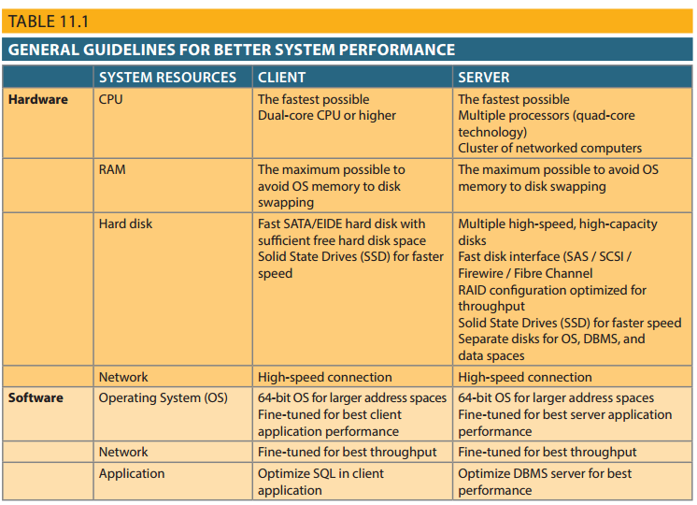
Table 11.1 - General Guidelines for Better System Performance
Copyright © 2017 Cengage Learning
4

Slide 5
Performance Tuning: Client and Server
Client side
SQL performance tuning: Generates SQL query that returns correct answer in least amount of time
Using minimum amount of resources at server
Server side
DBMS performance tuning: DBMS environment configured to respond to clients’ requests as fast as possible
Optimum use of existing resources
Copyright © 2017 Cengage Learning
5

Slide 6
DBMS Architecture
All data in a database are stored in data files
Data files automatically expand in predefined increments known as extends
Data files are grouped in file groups or table spaces
Table space or file group: Logical grouping of several data files that store data with similar characteristics
Data cache or buffer cache: Shared, reserved memory area
Stores most recently accessed data blocks in RAM
Copyright © 2017 Cengage Learning
6

Slide 7
DBMS Architecture
SQL cache or procedure cache: Stores most recently executed SQL statements or PL/SQL procedures
DBMS retrieves data from permanent storage and places them in RAM
Input/output request: Low-level data access operation that reads or writes data to and from computer devices
Data cache is faster than working with data files
Majority of performance-tuning activities focus on minimizing I/O operations
Copyright © 2017 Cengage Learning
7

Slide 8
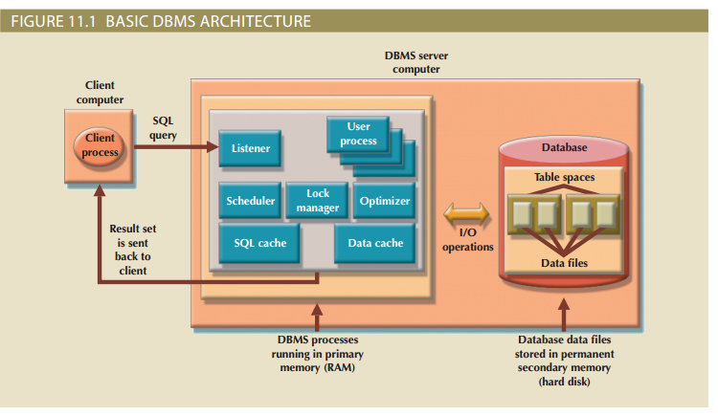
Figure 11.1 - Basic DBMS Architecture
Copyright © 2017 Cengage Learning
8

Slide 9
Database Query Optimization Modes
Algorithms proposed for query optimization are based on:
Selection of the optimum order of operations to achieve the fastest execution time
Selection of sites to be accessed to minimize communication costs
Evaluated on the basis of:
Operation mode
Timing of its optimization
Copyright © 2017 Cengage Learning
9

Slide 10
Classification of Operation Modes
Automatic query optimization: DBMS finds the most cost-effective access path without user intervention
Manual query optimization: Requires that the optimization be selected and scheduled by the end user or programmer
Copyright © 2017 Cengage Learning
10

Slide 11
Classification Based on Timing of Optimization
Static query optimization: best optimization strategy is selected when the query is compiled by the DBMS
Takes place at compilation time
Dynamic query optimization: Access strategy is dynamically determined by the DBMS at run time, using the most up-to-date information about the database
Takes place at execution time
Copyright © 2017 Cengage Learning
11

Slide 12
Classification Based on Type of Information Used to Optimize the Query
Statistically based query optimization algorithm: Statistics are used by the DBMS to determine the best access strategy
Statistical information is generated by DBMS through:
Dynamic statistical generation mode
Manual statistical generation mode
Rule-based query optimization algorithm: based on a set of user-defined rules to determine the best query access strategy
Copyright © 2017 Cengage Learning
12

Slide 13
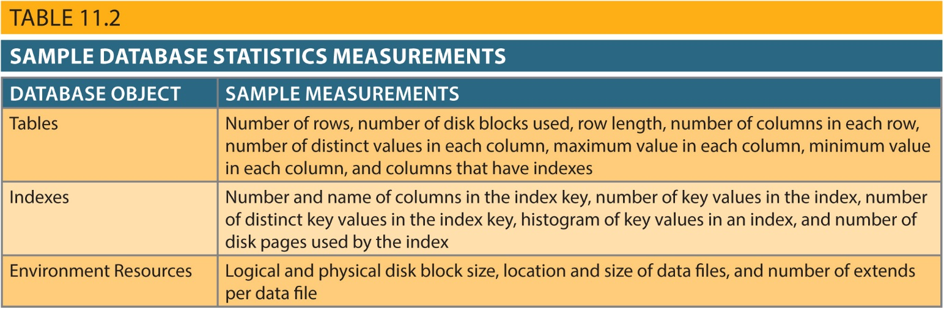
Table 11.2 - Sample Database Statistics Measurements
Copyright © 2017 Cengage Learning
13

Slide 14
Query Processing
Parsing
Execution
Fetching
DBMS parses the SQL query and chooses the most efficient access/execution plan
DBMS executes the SQL query using the chosen execution plan
DBMS fetches the data and sends the result set back to the client
Copyright © 2017 Cengage Learning
14

Slide 15
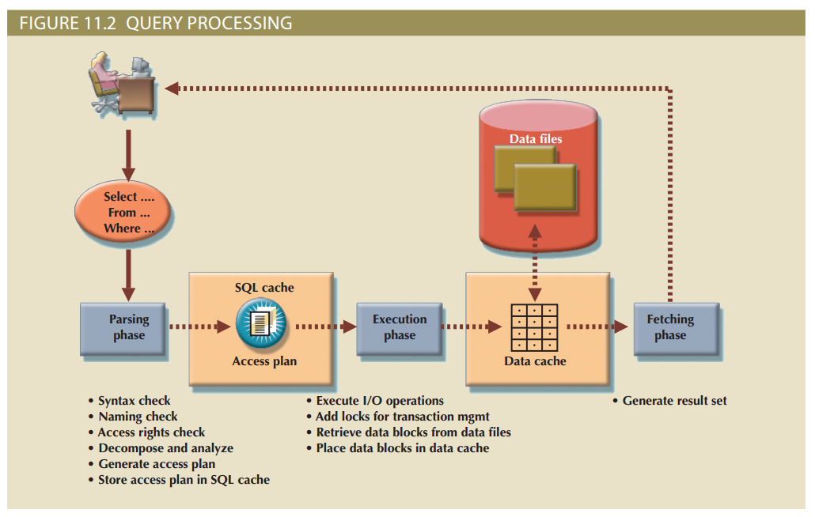
Copyright © 2017 Cengage Learning
15

Slide 16
SQL Parsing Phase
Break down query into smaller units
Transform original SQL query into slightly different version of original SQL code
Fully equivalent
Optimized query results are always the same as original query
More efficient
Optimized query will almost always execute faster than original query
Copyright © 2017 Cengage Learning
16

Slide 17
SQL Parsing Phase (cont’d.)
Query optimizer analyzes SQL query and finds most efficient way to access data
Validated for syntax compliance
Validated against data dictionary
Tables, column names are correct
User has proper access rights
Analyzed and decomposed into components
Optimized
Prepared for execution
Copyright © 2017 Cengage Learning
17

Slide 18
SQL Parsing Phase (cont’d.)
Access plans are DBMS specific
Translate client’s SQL query into a series of complex I/O operations
Required to read the data from the physical data files and generate result set
DBMS checks if access plan already exists for query in SQL cache
DBMS reuses the access plan to save time
If not, optimizer evaluates various plans
Chosen plan placed in SQL cache
Copyright © 2017 Cengage Learning
18

Slide 19
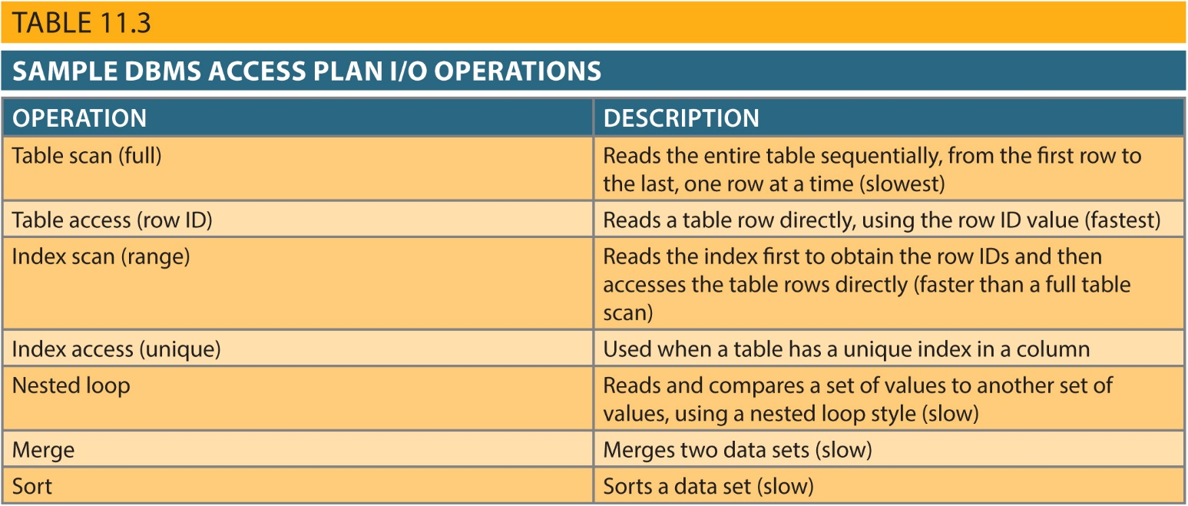
Sample Access Plan
I/O Operations
Copyright © 2017 Cengage Learning
19

Slide 20
SQL Execution Phase
All I/O operations indicated in the access plan are executed
Locks are acquired
Data are retrieved and placed in data cache
Transaction management commands are processed
Copyright © 2017 Cengage Learning
20

Slide 21
SQL Fetching Phase
Rows of resulting query result set are returned to client
DBMS may use temporary table space to store temporary data
Database server coordinates the movement of the result set rows from the server cache to the client cache
Copyright © 2017 Cengage Learning
21

Slide 22
Query Processing Bottlenecks
Delay introduced in the processing of an I/O operation that slows the system
Caused by the:
CPU
RAM
Hard disk
Network
Application code
Copyright © 2017 Cengage Learning
22

Slide 23
Summary
Database performance tuning
Refers to activities to ensure query is processed in minimum amount of time
SQL performance tuning
Refers to activities on client side to generate SQL code
Returns correct answer in least amount of time
Uses minimum amount of resources at server end
DBMS architecture is represented by processes and structures used to manage a database
Copyright © 2017 Cengage Learning
23

Slide 24
Summary (cont’d.)
Database statistics refers to measurements gathered by the DBMS
Describe snapshot of database objects’ characteristics
DBMS processes queries in three phases: parsing, execution, and fetching
Copyright © 2017 Cengage Learning
24

Slide 25
Task
Explain the purpose of the DBMS creating an access plan.
Copyright © 2017 Cengage Learning
25

